Slide 1
Rai et al.
Han, my comments to you are in red font on the slides. Please leave the comments and write to me how you addressed them.

Slide 2
Treatment name on graphs | Age 12 – 14 (before spray) | Age 15 – 27 (after spray)
C/C | Cornmeal | Cornmeal
C/G | Cornmeal | Glucose
G/G | Glucose | Glucose
G/C | Glucose | Cornmeal
Notes:
Table S1. Dietary treatments of Experiment 3. For each dietary condition, half of the flies were inoculated and half were treated as controls. Flies were reared on a Cornmeal diet until age 12 from egg. Then some flies received Cornmeal and some received Glucose diet. After flies were sprayed at age 15 days from egg, some flies received Cornmeal and some Glucose diet. Days here are given from egg.

Slide 3
Treatment name on graphs | Day 12 – 14 (before spray) | Day 15 – 27 (after spray)
C/C | Cornmeal | Cornmeal
C/CY | Cornmeal | Cornmeal with yeast supplement
CY/C | Cornmeal with yeast supplement | Cornmeal
CY/CY | Cornmeal with yeast supplement | Cornmeal with yeast supplement
G/G | Glucose | Glucose
Notes:
Table S2. Dietary treatments of Experiment 4. For each dietary condition, half of the flies were inoculated and half were treated as controls. All flies were reared on a Cornmeal diet until age 12 from egg. Then the specific dietary conditions were applied. Days here are given from egg.

Slide 4
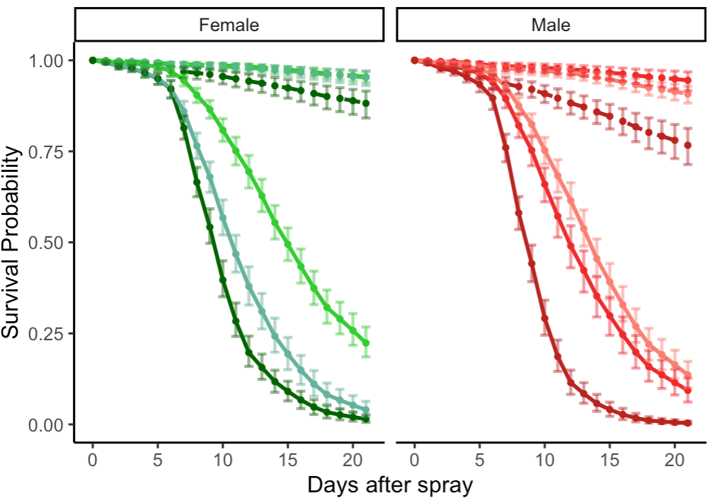
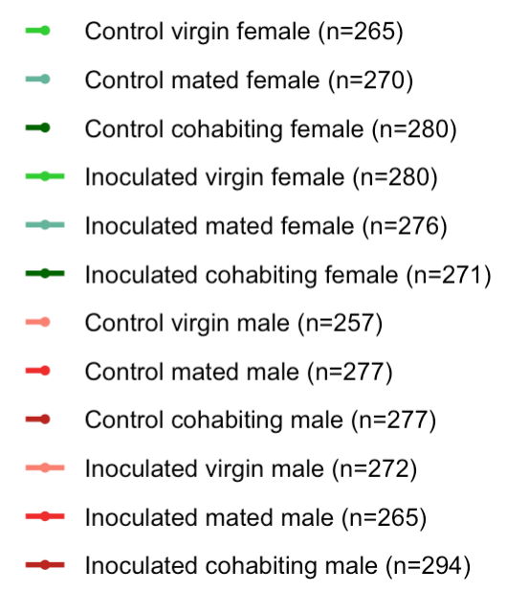
New plot: 06/01
Notes:
Figure1. Survival post inoculation with Beauveria bassiana is affected by mating status in both males and females. Data from Experiment 1. Flies were sprayed with fungal suspension (n = 1658, solid lines) or with a control, fungus-free suspension (n = 1626, dashed lines) at age 17 days from egg, and survival was followed for 21 days. In both females (green) and males (red), mated flies (which mated for 24 hours prior to the spray) had lower survival than virgin flies, and flies that mated for longer than one day (cohabiting flies, which mated for 24 hours prior to spray and then cohabited with the other sex after the spray) had lower survival than mated flies (see Table S1 for statistical analysis). This figure shows model estimates for survival proportions, which are obtained from the raw survival data (Figure S1).

Slide 5
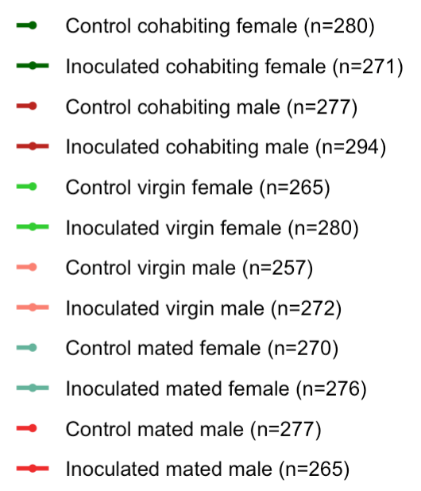
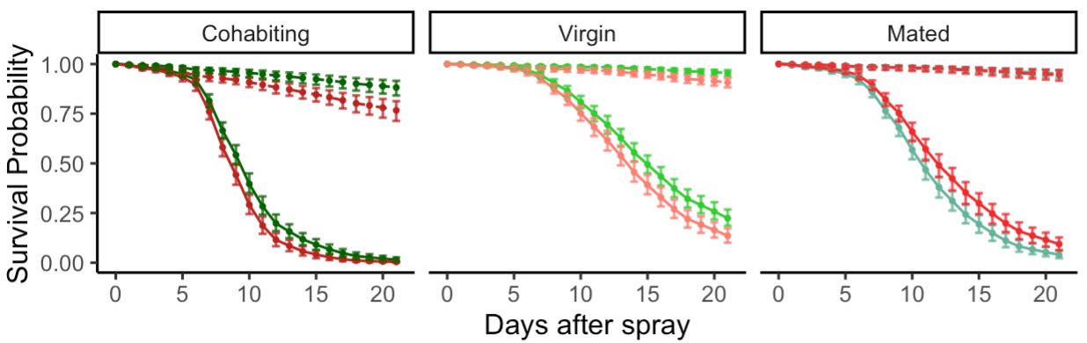
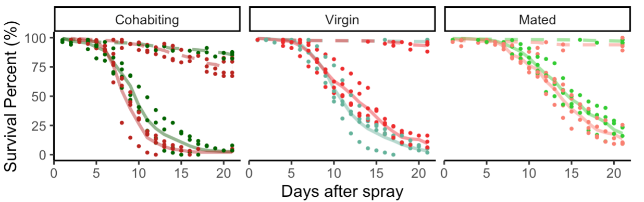
I combined these two sets of graph. Please make the format match as much as possible.
Change “cohabit” in the legend to “cohabiting” and “fungal” to “inoculated” – make these change on all graphs and tables that have “cohabit” and “fungal”
A
B
New plot: 06/03
Notes:
Figure S1. Sexual dimorphism in survival of D. melanogaster inoculated with B. bassiana strain ARSEF 12460 is affected by mating status. Data from Experiment 1. Female (green) and male (red) survival after control spray (dashed lines) and fungal spray (solid lines) is shown for cohabiting flies, virgin flies, and mated flies which mated for only 24 hours. Survival was followed for 21 days after the spray. Sample sizes per treatment are provided in the legend. The top graphs show model estimates for survival proportions, using four replicates of raw data with 95% Bootstrap confidence intervals. See Tables S1 and S2 for statistical analysis of this data. Bottom graphs show the raw data for the four replicates of each treatment and the means. For cohabiting and virgin flies, females had better survival than males after inoculation. For mated flies, this trend was reversed. In both females and males, virgin survival was higher than mated survival, which was itself higher than survival under cohabiting condition.

Slide 6
Treatment | Sex | Hazard ratios between mating status | 0 – 5 | 5 – 11 | 11 – 21
Control | Female | Mated vs Virgins (p-value) | 1.28 (0.4978) | 1.24 (0.4446) | 0.93 (0.8012)
Control | Female | Cohabiting vs Virgins (p-value) | 2.79 (0.0014) | 4.59 (<0.0001) | 2.29 (<0.0001)
Control | Female | Cohabiting vs Mated (p-value) | 2.19 (0.0219) | 3.69 (0.0003) | 2.46 (0.0046)
Control | Male | Mated vs Virgins (p-value) | 0.70 (0.3297) | 0.69 (0.1956) | 0.52 (0.0238)
Control | Male | Cohabiting vs Virgins (p-value) | 2.79 (0.0014) | 4.59 (<0.0001) | 2.29 (<0.0001)
Control | Male | Cohabiting vs Mated (p-value) | 3.96 (0.0005) | 6.69 (<0.0001) | 4.45 (<0.0001)
Inoculated | Female | Mated vs Virgins (p-value) | 2.72 (0.0041) | 2.65 (<0.0001) | 1.99 (<0.0001)
Inoculated | Female | Cohabiting vs Virgins (p-value) | 2.79 (0.0014) | 4.59 (<0.0001) | 2.29 (<0.0001)
Inoculated | Female | Cohabiting vs Mated (p-value) | 1.03 (0.9073) | 1.73 (0.0001) | 1.15 (0.3419)
Inoculated | Male | Mated vs Virgins (p-value) | 1.50 (0.1854) | 1.46 (0.0098) | 1.10 (0.4450)
Inoculated | Male | Cohabiting vs Virgins (p-value) | 2.79 (0.0014) | 4.59 (<0.0001) | 2.29 (<0.0001)
Inoculated | Male | Cohabiting vs Mated (p-value) | 1.86 (0.0178) | 3.14 (<0.0001) | 2.09 (0.0002)
New table: 06/04
Notes:
Table S3. Hazard ratios and p-Values when comparing mating statuses in both control and fungal inoculated Drosophila melanogaster. Data from Experiment 1.
Hazard ratios and p-Values are presented in the time intervals of 0-5, 5-11, and 11-21 days post inoculation.

Slide 7
Treatment | Mating status | Hazard ratios between sex | 0 – 21
Control | Virgins | Male vs Female (p-value) | 2.11 (0.0016)
Control | Mated | Male vs Female (p-value) | 1.16 (0.4805)
Control | Cohabiting | Male vs Female (p-value) | 1.33 (0.0013)
Inoculated | Virgins | Male vs Female (p-value) | 2.11 (0.0016)
Inoculated | Mated | Male vs Female (p-value) | 0.74 (0.0084)
Inoculated | Cohabiting | Male vs Female (p-value) | 1.33 (0.0013)
New table: 06/04
Notes:
Table S4. Hazard ratios and p-Values when comparing males and females under different mating statuses in both control and fungal inoculated Drosophila melanogaster. Data from Experiment 1. Hazard ratios and p-values are presented for days 0-21 post inoculation.

Slide 8
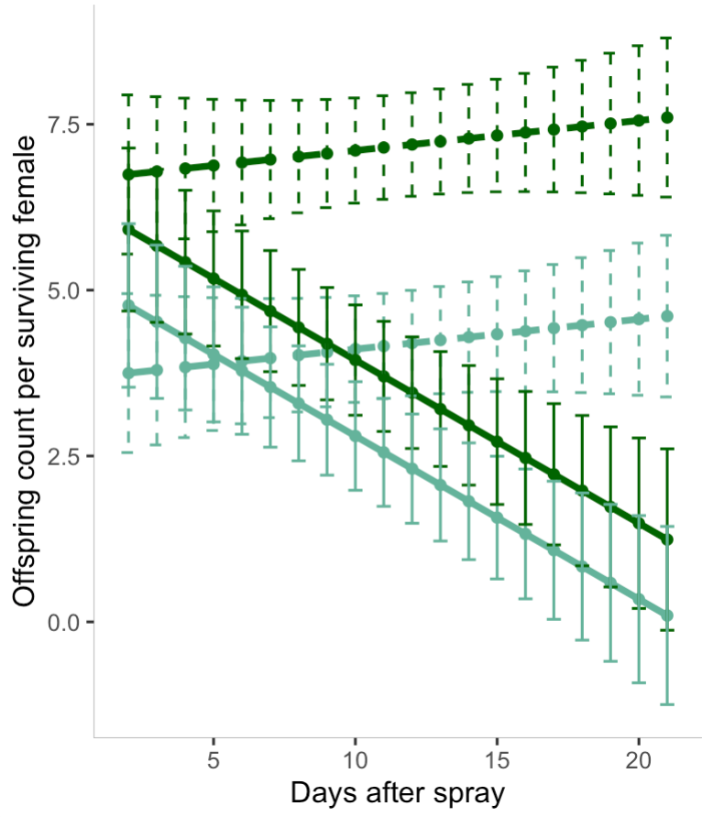
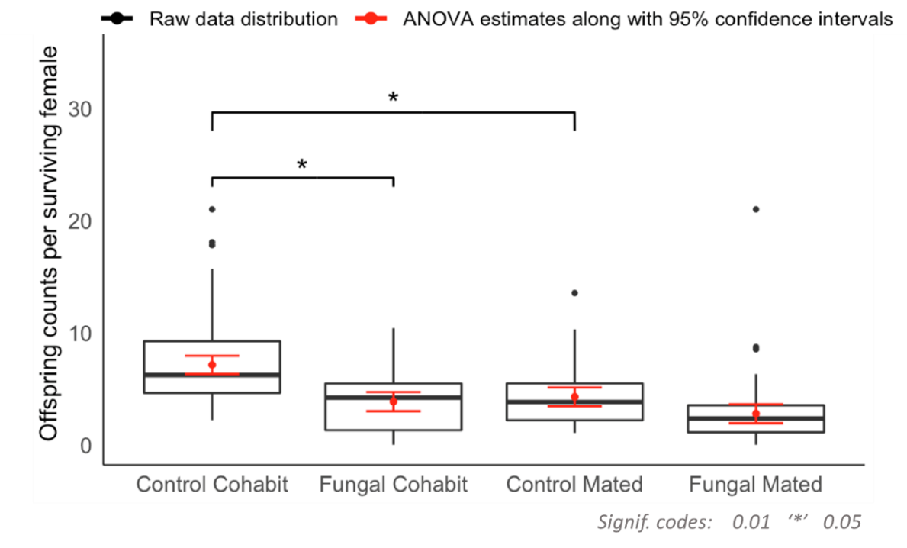
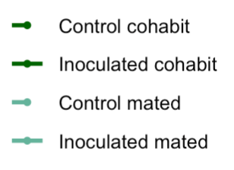
A
B
Control Cohabit
Inoculated Cohabit
Control Mated
Inoculated
Mated
New plot: 06/04
Notes:
Figure 2. Reproductive output of mated and cohabiting females in control and fungal inoculated conditions. Data from Experiment 1. (A) Analysis of variance for the offspring counts. The data points are plotted for 95% confidence intervals. Offspring count was lower for fungal inoculated females than for control females (p-value : $3.313×{10}^{−8}$). Among control females, those that cohabited with males had higher offspring counts compared to those who mated for only 24 hours (p-value: $4.534×{10}^{−6}$). There was an interaction effect between treatment (inoculated/control) and mating status (cohabited/mated) with a p-value of $3.725×{10}^{−2}$. (B) Box plot shows the raw data distribution of offspring counts per surviving female and predicted mean value for cohabited and mated females. Black dots represent the outliers while red lines represents the 95% confidence intervals. Among females in the cohabiting condition, controls had higher offspring count that fungal inoculated females (p-value: 0.01203), but among mated females, there was no significant difference between offspring counts in control and fungal inoculated conditions (p-value: 0.08702). Among uninfected controls, cohabiting females had higher offspring counts than mated females (p-value: 0.01687). However, among fungal inoculated flies, offspring counts of cohabiting females did not differ from those of mated females (p-value: 0.17707).

Slide 9
 | Df | Sum Sq | Mean Sq | F value | Pr(>F)
Day | 1 | 55.19 | 55.19 | 5.8532 | 0.01634*
Treatment | 1 | 363.70 | 363.70 | 38.5723 | 2.505e-09***
Mating_status | 1 | 229.53 | 229.53 | 24.3426 | 1.564e-06***
Treatment:Mating_status | 1 | 47.40 | 47.40 | 5.0270 | 0.02593*
Day:Treatment | 1 | 163.88 | 163.88 | 17.3799 | 4.361e-05***
Residuals | 226 | 2130.98 | 9.43
New table: 06/04
Notes:
Table S5. Analysis of variance for reproductive output data from mated and cohabiting females. Data from Experiment 1. The data strongly supports the difference on offspring counts between the fungal inoculated groups and the controls (p-value:$2.505×{10}^{−9}$) . The data also strongly supports that cohabited and mated groups differ in their offspring counts (p-value: $1.564×{10}^{−6}$).
* p-value ≤ 0.05, *** p-value ≤ 0.001

Slide 10
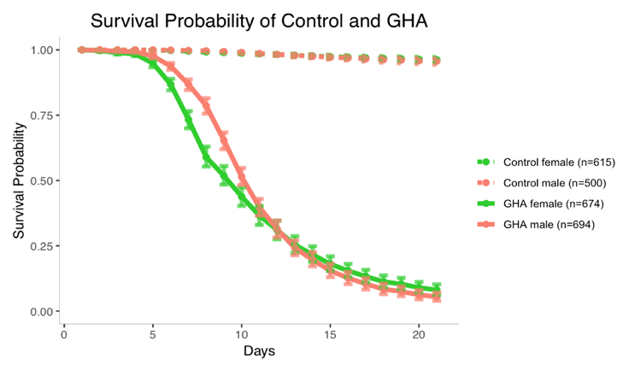
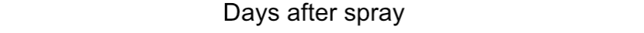
Notes:
Figure 3. Sexual dimorphism in survival of D. melanogaster after inoculation with B. bassiana strain GHA. Data from Experiment 2. Figure shows model estimates with 95% Bootstrap confidence intervals from the raw data shown in Figure S2. Inoculated males survived better than inoculated females until day 12 post spray. See Table S4 for statistical analysis.

Slide 11
Treatment | Hazard ratios between sex | 0 – 8 | 8 – 12 | 12 – 21
GHA | Male vs Female (p-value) | 0.403 (0.00043) | 1.268 (0.03486) | 1.245 (0.07487)
New table: 06/24
Notes:
Table S6. Hazard ratios and p-values for males vs females in GHA inoculated flies. Data from Experiment 2. The hazard ratios indicate the risk of male flies dying post inoculation in comparison to the female flies. The data strongly supports that there is sexual dimorphism in post inoculation survival in the 0-8 and 8-12 age intervals. However the p-value in the 12-21 days interval suggests there is no sexual dimorphism in survival in this interval.

Slide 12
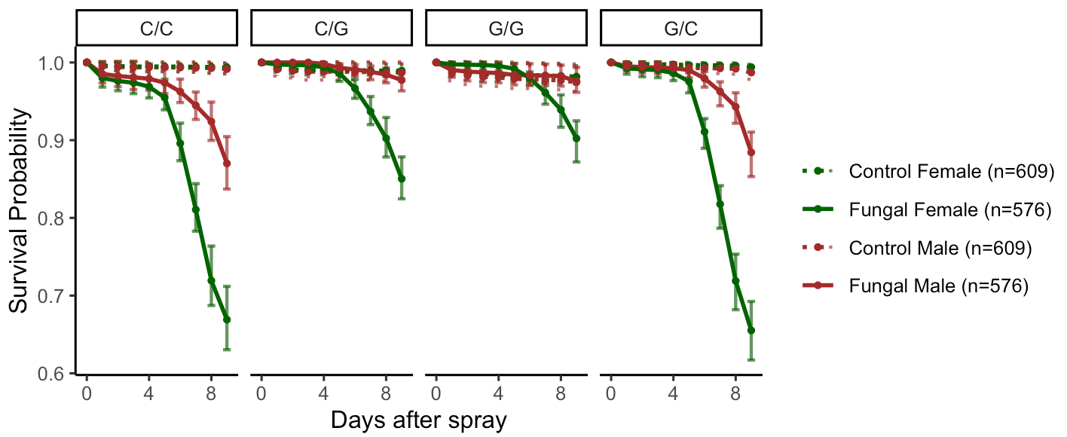
Fix y scale so it matches in all the graphs.
Check the graph titles, I think you might have the middle two reversed.
The one you labelled “C/G” was actually “G/G”? Can you double check to make sure.
Diet switched at Day 9 so cut off at Day 9
Labels checked.
Diet 2
New plot: 06/19
Notes:
Figure 4. Effects of diet on post-inoculation survival of D. melanogaster inoculated with B. bassiana strain GHA. Data from Experiment 3. Figure shows model estimates with 95% Bootstrap confidence intervals from the raw data shown in Figure S3. For analysis of these data see Tables S4 and S5. Inoculated flies had lower survival than control flies. There was no sexual dimorphism observed among control flies, but among inoculated flies males survived better than females. The timing of introduction of a glucose diet affected post inoculation survival.

Slide 13
The 9-12 day information here doesn’t seem to match what is shown on the graphs on slide 12.
For example for C/C, this would imply that among infected flies there is no sexual dimorphism in the 9-12 day interval, but the graphs look like there is a difference?
There is no sexual dimorphism (in terms of hazard ratio) for C/C at the last time interval (day8 to day9) because the slope of female and the slope of male is very close to each other from day 8 to day 9, which means two groups of flies die at the same rate. Same reason for G/G.
Treatment | Diet | Hazard ratios between Sex | 0 – 3 | 3 – 5 | 5 – 8 | 8 – 9
Control | C/C | Female vs Male (p-value) | 0.825 (0.53663) | 0.249 (0.2202) | 0.664 (0.6559) | 0.398 (0.2762)
Control | C/G | Female vs Male (p-value) | 0.825 (0.53663) | 0.249 (0.2202) | 0.664 (0.6559) | 0.398 (0.2762)
Control | G/C | Female vs Male (p-value) | 0.825 (0.53663) | 0.249 (0.2202) | 0.664 (0.6559) | 0.398 (0.2762)
Control | G/G | Female vs Male (p-value) | 0.825 (0.53663) | 0.249 (0.2202) | 0.664 (0.6559) | 0.398 (0.2762)
Inoculated | C/C | Female vs Male (p-value) | 1.371 (0.4307) | 2.780 (0.0863) | 5.377 (1.0553e-10) | 1.203 (0.4769)
Inoculated | C/G | Female vs Male (p-value) | 5.385e+06 (0.9925) | 1.505 (0.5299) | 10.071 (1.0767e-05) | 6.116 (0.0016)
Inoculated | G/C | Female vs Male (p-value) | 1.500 (0.5326) | 4.537 (0.0589) | 6.252 (5.5698e-12) | 1.443 (0.1193)
Inoculated | G/G | Female vs Male (p-value) | 0.249 (0.0848) | 1.486 (0.6661) | 33.574 (0.0011) | 8.394 (0.0002)
New table: 06/19
Notes:
Table S7. Diet affects sexual dimorphism of D. melanogaster inoculated with B. bassiana strain GHA in a sex-specific manner. Data from Experiment 3. There was no sexual dimorphism in survival among the control treatments, regardless of diet. However, among fungal inoculated flies, males survived better than females in some age intervals on every diet. The timing of introduction of a Glucose diet has an impact on the Hazard ratio among inoculated flies.

Slide 14
Sex | Treatment | Hazard ratios between Diet | 0 – 3 | 3 – 5 | 5 – 8 | 8 – 9
Male | Control | C/C (baseline) | 1 | 1 | 1 | 1
Male | Control | C/G (p-value) | 1.880 (0.1978) | 1.005 (0.9999) | 1.199 (0.8982) | 0.943 (0.9902)
Male | Control | G/C (p-value) | 0.451 (0.2543) | 1.487e+07 (0.9940) | 1.054 (0.9940) | 4.228 (0.2034)
Male | Control | G/G (p-value) | 2.970 (0.0161) | 9.393e+06 (0.9941) | 1.995 (0.5755) | 2.001 (0.5739)
Male | Inoculated | C/C (p-value) | 3.059 (0.9902) | 2.534e+07 (0.9938) | 53.097 (5.9403e-04) | 50.792 (4.5510e-04)
Male | Inoculated | C/G (p-value) | 1.025e-07 (0.9922) | 2.491e+07 (0.9938) | 8.866 (0.0647) | 6.001 (0.1235)
Male | Inoculated | G/C (p-value) | 1.037 (0.9548) | 1.173e+07 (0.9940) | 4.920e+01 (7.3614e-04) | 5.440e+01 (3.6220e-04)
Male | Inoculated | G/G (p-value) | 2.046 (0.1881) | 1.158e+07 (0.9940) | 1.643 (0.7355) | 5.539 (0.1407)
Female | Control | C/C (p-value) | 1 | 1 | 1 | 1
Female | Control | C/G (p-value) | 1.880 (0.1978) | 1.005 (0.9999) | 1.199 (0.8982) | 0.943 (0.9902)
Female | Control | G/C (p-value) | 0.451 (0.2543) | 1.487e+07 (0.9940) | 1.054 (0.9940) | 4.228 (0.2034)
Female | Control | G/G (p-value) | 2.970 (0.0161) | 9.393e+06 (0.9941) | 1.995 (0.5755) | 2.001 (0.5739)
Female | Inoculated | C/C (p-value) | 5.086 (0.0017) | 2.824e+08 (0.9931) | 4.299e+02 (2.8914e-06) | 1.536e+02 (9.4315e-05)
Female | Inoculated | C/G (p-value) | 0.669 (0.6265) | 1.503e+08 (0.9931) | 1.344e+02 (9.4315e-05) | 1.266e+02 (1.5734e-04)
Female | Inoculated | G/C (p-value) | 1.888 (0.2802) | 2.133e+08 (0.9930) | 4.632e+02 (2.2898e-06) | 1.973e+02 (4.4526e-05)
Female | Inoculated | G/G (p-value) | 0.617 (0.5587) | 6.902e+07 (0.9934) | 8.304e+01 (3.7280e-04) | 8.514e+01 (4.7180e-04)
Combine into one table with two parts.
Complete the table legend.
New table: 06/19
Diet 2
Notes:
Table S8. ExpEffects of dietary condition and infection status on male and female survival in different age groups. Data from Experiment 3. ADD STATEMENT ABOUT EFFECTS OF GLUCOSE AND EFFECTS OF TIMING OF ITS INTRODUCTION.

Slide 15
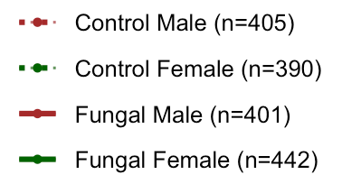
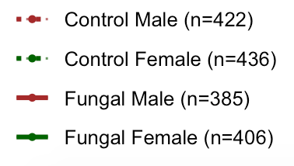
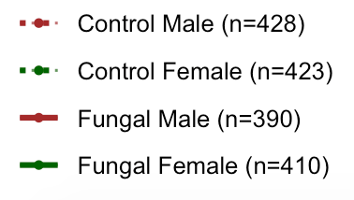
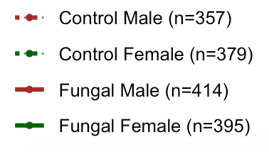

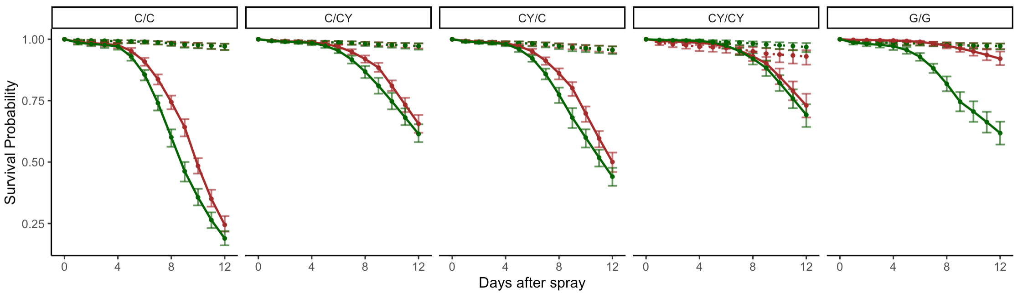
Fix y scale so it is the same in all the graphs
According to the stats table there is no difference between the red and green in the C/CY. This is true?
Yes, it’s true that there is no difference between red and green in C/CY because the day by day vertical distance in between isn’t large enough.
New plot: 06/23
Diet 1
Notes:
Figure 5. Yeast supplementation affects sexual dimorphism in survival of D. melanogaster inoculated with B. bassiana strain GHA. Data from Experiment 4. The figure shows model estimates for the raw data shown in Figure S4. Three days prior to control spray (dashed lines) or fungal spray (solid lines), flies were given Cornmeal (C), Cornmeal with yeast supplement (CY), or Glucose (G) diets (marked before the dash in the figure headings). After the spray which was on day 15 from egg, flies were kept on one of the three types of diets (C, CY, or G, marked after the dash in the figure headings). Yeast supplementation improved survival of inoculated flies. When yeast supplementation was provided after the inoculation, sexual dimorphism was ablated. But there was sexual dimorphism among control flies when yeast supplementation was provided both before and after the spray. See Tables S6 for analysis of these results.

Slide 16
Treatment | Sex | Hazard ratios between Diet | 0 – 4 | 4 – 9 | 9 – 12
Control | Male | C/CY vs C/C (p-value) | 1.443 (0.5725) | 0.383 (0.2577) | 0.190 (0.1370)
Control | Male | CY/C vs C/C (p-value) | 1.188 (0.799) | 1.331 (0.6275) | 1.144 (0.8257)
Control | Male | CY/CY vs C/C (p-value) | 3.158 (0.0551) | 2.338 (0.1281) | 0.946 (0.9344)
Control | Male | G/G vs C/C (p-value) | 1.203 (0.7846) | 1.542 (0.4511) | 8.814e-07 (0.9763)
Control | Female | C/CY vs C/C (p-value) | 1 | 1 | 1
Control | Female | CY/C vs C/C (p-value) | 1 | 1 | 1
Control | Female | CY/CY vs C/C (p-value) | 1 | 1 | 1
Control | Female | G/G vs C/C (p-value) | 1 | 1 | 1
Inoculated | Male | C/CY vs C/C (p-value) | 0.577 (0.3288) | 0.218 (6.0601e-10) | 0.334 (8.4624e-11)
Inoculated | Male | CY/C vs C/C (p-value) | 0.453 (0.1946) | 0.553 (0.0001) | 0.497 (9.4268e-07)
Inoculated | Male | CY/CY vs C/C (p-value) | 0.644 (0.4090) | 0.216 (2.6627e-10) | 0.221 (8.2823e-14)
Inoculated | Male | G/G vs C/C (p-value) | 0.813 (0.6830) | 0.059 (1.7262e-10) | 0.041 (6.6613e-15)
Inoculated | Female | C/CY vs C/C (p-value) | 0.628 (0.3339) | 0.282 (2.2922e-12) | 0.284 (6.0437e-11)
Inoculated | Female | CY/C vs C/C (p-value) | 0.535 (0.2171) | 0.467 (2.6667e-08) | 0.479 (1.9271e-06)
Inoculated | Female | CY/CY vs C/C (p-value) | 0.462 (0.1540) | 0.155 (1.3323e-14) | 0.261 (8.6758e-12)
Inoculated | Female | G/G vs C/C (p-value) | 0.7981 (0.6115) | 0.348 (5.3968e-11) | 0.222 (4.2175e-12)
Update this table with baseline being C,C instead of C, C+Y
New table: 06/23
Diet 1
Notes:
Table S9. Effect of diet on survival of males and females combined when inoculated with B. bassiana GHA. Data from Experiment 4. Hazard ratios and p-values are presented from 0-4, 4-9 and 9-14 days post inoculation.

Slide 17
Treatment | Diet | Hazard ratios between Sex | 0 – 4 | 4 – 9 | 9 – 12
Control | C/C | Female vs Male (p-value) | 1.300 (0.2228) | 0.880 (0.7970) | 0.680 (0.4515)
Control | C/CY | Female vs Male (p-value) | 0.901 (0.8189) | 2.296 (0.2665) | 3.569 (0.2228)
Control | CY/C | Female vs Male (p-value) | 1.09 (0.8538) | 0.661 (0.3448) | 0.594 (0.9770)
Control | CY/CY | Female vs Male (p-value) | 0.412 (0.0175) | 0.376 (0.0138) | 0.718 (0.5546)
Control | G/G | Female vs Male (p-value) | 1.081 (0.8734) | 0.570 (0.1805) | 7.709e+05 (0.9700)
Inoculated | C/C | Female vs Male (p-value) | 1.215 (0.6606) | 1.832 (1.4197e-06) | 0.950 (0.6735)
Inoculated | C/CY | Female vs Male (p-value) | 1.324 (0.2228) | 2.364 (0.2228) | 0.806 (0.1728)
Inoculated | CY/C | Female vs Male (p-value) | 1.434 (0.5796) | 1.549 (0.0040) | 0.915 (0.4867)
Inoculated | CY/CY | Female vs Male (p-value) | 0.871 (0.6606) | 1.312 (0.2391) | 1.123 (0.4867)
Inoculated | G/G | Female vs Male (p-value) | 1.193 (0.7279) | 10.748 (2.0011e-08) | 5.126 (1.8983e-06)
Make the two tables line up better. Organize.
New table: 06/23
Diet 1
Notes:
Table S10. Yeast supplementation affects sexual dimorphism in surviving infection. Data from Experiment 4. Whenever yeast supplementation was provided after inoculation, it ablated the sexual dimorphism in survival. However, when yeast supplementation was provided before and after the spray, there was sexual dimorphism among uninfected control flies. The hazard ratio, showing difference in hazard between males and females is largest for flies that received the glucose diet.

Slide 18
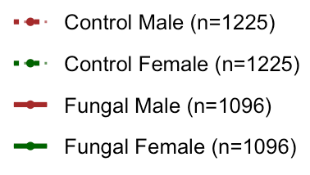
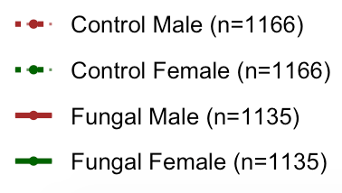
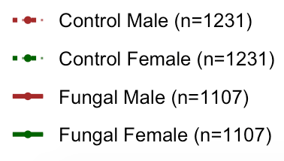
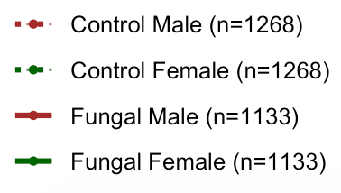
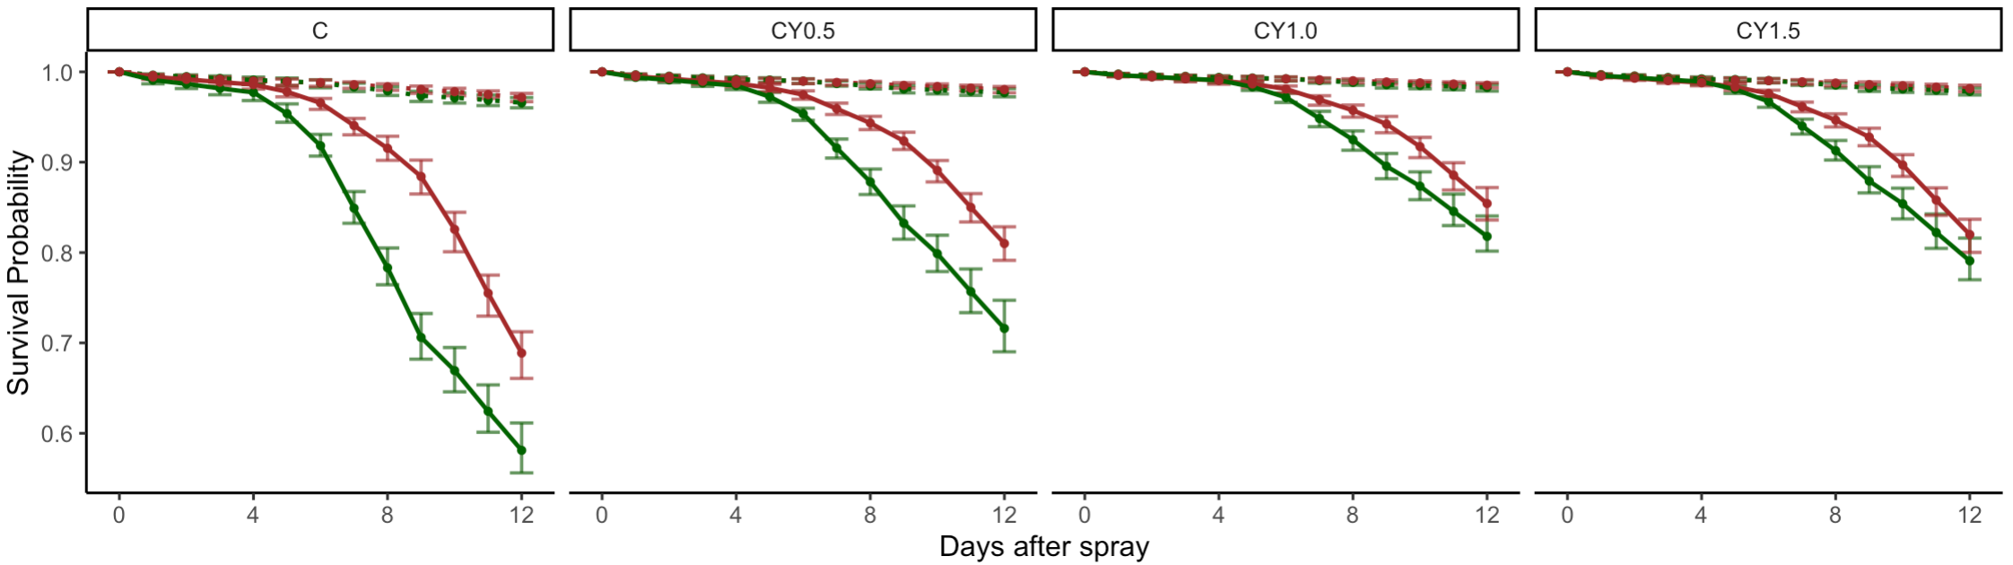
Cut off data at 12. Make y axes all the same.
New plot: 06/23
Notes:
Figure 6: Level of yeast supplementation affects sexual dimorphism in survival when D. melanogaster are inoculated with B. bassiana GHA. The figure shows model estimates and 95% confidence intervals for the raw data shown in Figure S5. All flies were reared on cornmeal diets. After the sprays, flies received cornmeal diets supplemented with varying levels of yeast. See Tables S7 and S8 for statistical analysis of these results.

Slide 19
Treatment | Sex | Hazard ratios between Diet | 0 – 5 | 5 – 8 | 8 – 12
Inoculated | Male | CY0.5 vs C (p-value) | 1.303 (0.3577) | 0.283 (0.0243) | 0.508 (0.0113)
Inoculated | Male | CY1.0 vs CY0.5 (p-value) | 0.931 (0.7229) | 1.002 (0.9941) | 0.676 (0.0009)
Inoculated | Male | CY1.5 vs CY1.0 (p-value) | 0.899 (0.5556) | 1.290 (0.0768) | 1.268 (0.0768)
Inoculated | Female | CY0.5 vs C (p-value) | 0.537 (0.0243) | 0.496 (8.3668e-07) | 0.749 (0.0113)
Inoculated | Female | CY1.0 vs CY0.5 (p-value) | 0.883 (0.6568) | 0.464 (1.4921e-05) | 0.644 (0.0004)
Inoculated | Female | CY1.5 vs CY1.0 (p-value) | 0.899 (0.5556) | 1.290 (0.0768) | 1.268 (0.0768)
New table: 06/23
Notes:
Table S11. Experiment 5. Intermediate levels of yeast supplementation improved survival. Pairwise comparisons of survival are shown, comparing the control (no yeast) condition with the lowest yeast level, the lowest and intermediate yeast levels, and the intermediate and high yeast levels. In both males and females, survival is improved by low and intermediate levels of yeast supplementation.

Slide 20
Make the two tables line up better, organize
Treatment | Diet | Hazard ratios between Sex | 0 – 5 | 5 – 8 | 8 – 12
Control | C | Female vs Male (p-value) | 1.065 (0.7612) | 1.145 (0.6556) | 1.030 (0.9010)
Control | CY0.5 | Female vs Male (p-value) | 1.065 (0.7612) | 1.145 (0.6556) | 1.030 (0.9010)
Control | CY1.0 | Female vs Male (p-value) | 1.065 (0.7612) | 1.145 (0.6556) | 1.030 (0.9010)
Control | CY1.5 | Female vs Male (p-value) | 1.065 (0.7612) | 1.145 (0.6556) | 1.030 (0.9010)
Inoculated | C | Female vs Male (p-value) | 1.711 (0.0261) | 4.794 (5.9931e-10) | 0.854 (0.1147)
Inoculated | CY0.5 | Female vs Male (p-value) | 0.936 (0.0261) | 4.404 (2.4345e-09) | 1.192 (0.1002)
Inoculated | CY1.0 | Female vs Male (p-value) | 0.938 (0.7534) | 2.805 (3.5543e-07) | 1.043 (0.6100)
Inoculated | CY1.5 | Female vs Male (p-value) | 0.938 (0.7534) | 2.805 (3.5543e-07) | 1.043 (0.6100)
New table: 06/24
Notes:
Table S12. There was no sexual dimorphism in survival among control flies. Data from Experiment 5. When flies were inoculated with fungus, there was sexual dimorphism on all diets, but the age intervals and magnitudes of this dimorphism changed with the level of yeast supplementation. When there is no yeast supplement or a little amount of supplement, the dimorphism starts at earlier ages than with higher levels of yeast supplement.

Slide 21
THE REMAINDER OF THE SLIDES ARE NOT PART OF THE PAPER. We may decide to add them back if reviewers ask for them, but I plan to exclude them for the initial submission.

Slide 22
excluded
Yeast supplement
Yeast after spray resulted in higher survival than cornmeal diet after spray on fungal treatment only. No such difference between control flies.
Baseline: C/CY |  | Control |  |  | Fungal
Days |  | 0-4 | 4-9 | 9-12 | 0-4 | 4-9 | 9-12
C/C Male | Hazard ratio (p-value) | 0.693 (0.5725) | 2.610 (0.2577) | 5.252 (0.2577) | 1.734 (0.3288) | 4.577 (6.0606e-10) | 2.991 (8.4623e-11)
C/C Female | Hazard ratio (p-value) | 0.693 (0.5725) | 2.610 (0.2577) | 5.252 (0.2577) | 1.591 (0.3339) | 3.547 (2.2922e-12) | 3.526 (6.0437e-11)
Baseline: CY/CY |  | Control |  |  | Fungal
Days |  | 0-4 | 4-9 | 9-12 | 0-4 | 4-9 | 9-12
CY/C Male | Hazard ratio (p-value) | 0.376 (0.0765) | 0.569 (0.2593) | 1.209 (0.7702) | 0.703 (0.5882) | 2.560 (3.0444e-5) | 2.249 (2.5324e-06)
CY/C Female | Hazard ratio (p-value) | 0.376 (0.0765) | 0.569 (0.2593) | 1.209 (0.7702) | 0.435 (0.3104) | 3.022 (1.4657e-07) | 1.833 (0.0003)
Diet 1
Notes:
EXCLUDE.
Yeast supplementation affects sexual dimorphism in survival of D. melanogaster inoculated with B. bassiana strain GHA. Three days prior to control spray (dashed lines) or fungal spray (solid lines), flies were given Cornmeal (C), Cornmeal with yeast supplement (CY), or Glucose (G) diets, marked before the dash in the figure headings. After the spray on day 15 from egg, flies were kept on one of the three types of diets (marked after the dash in the figure headings).
II. Sexual dimorphism
Sexual dimorphism exists (female survives better) for CY/CY group from day 0-9 after spray under control treatment, but it does not exist under fungal treatment.
Sexual dimorphism exists (male survives better) for C/C group from day 3-9 after spray under fungal treatment, but it does not exist under control treatment. Same results for CY/C group.
Sexual dimorphism exists (male survives better) for G/G group from day 3-12 after spray under fungal treatment, but it does not exist under control treatment.
Can we make these conclusions from the analysis?
Yeast supplement after the spray resulted in higher survival than cornmeal diet after spray
Sexual dimorphism was ablated when yeast supplement was given before and after spray
Female survival was the same when given yeast supplement after spray or when on glucose diet, but male survival was better on glucose diet
Sexual dimorphism was most pronounced on glucose diet

Slide 23
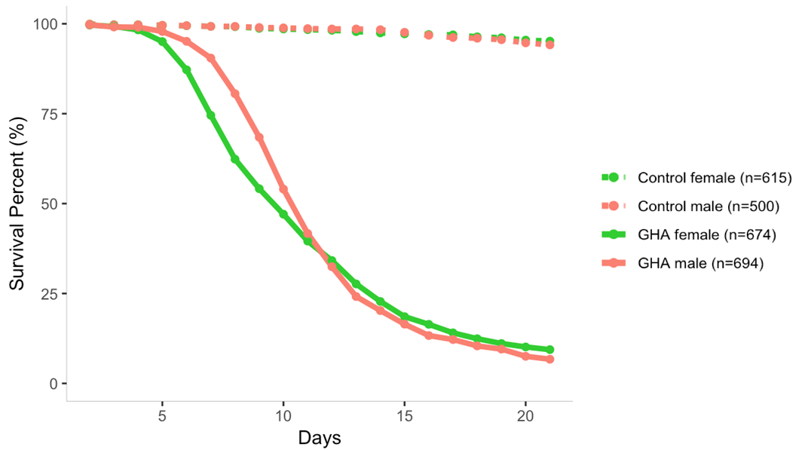
add the data points for all replicates on top of these trend lines and get rid of the mean points.
Notes:
EXCLUDE.
Figure S2. Experiment 2. Raw data showing survival percentage of control and GHA inoculated males and females. The points show data from three replicates and the lines are the means of the three replicates.

Slide 24
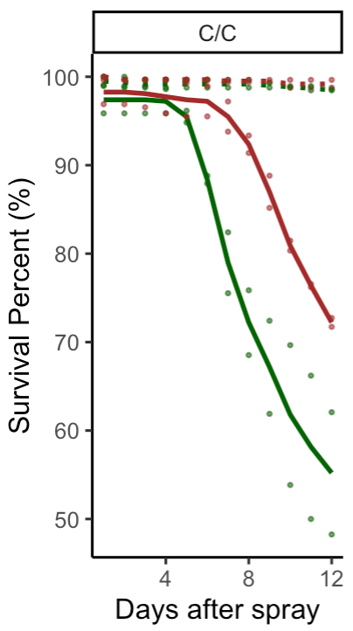
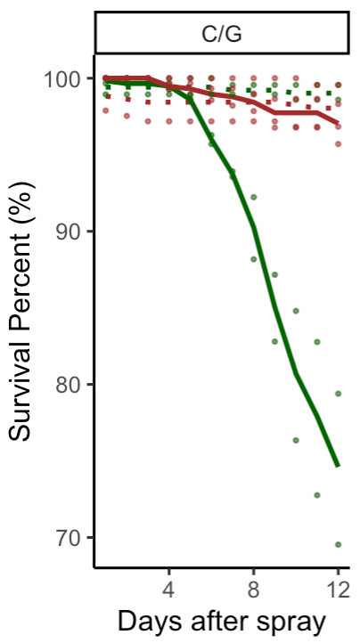
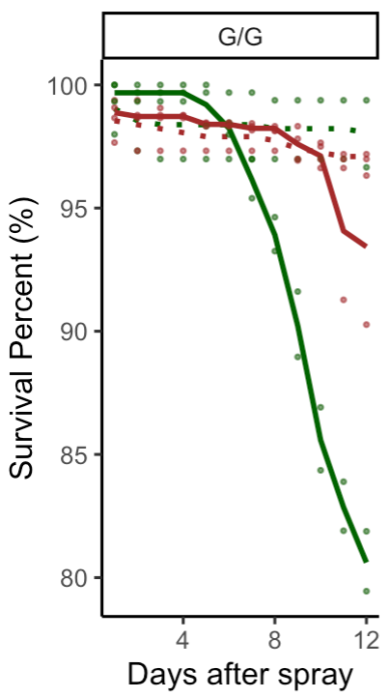
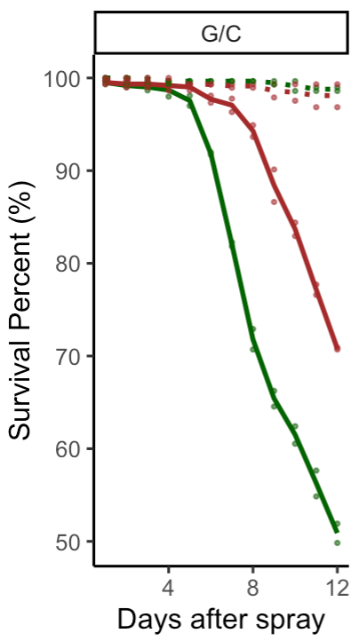
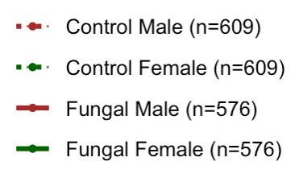
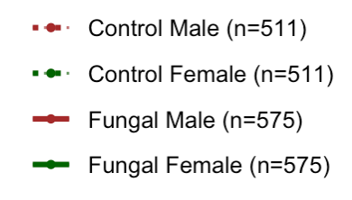
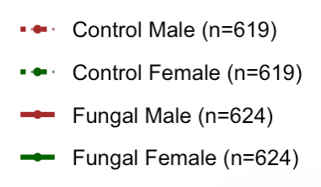
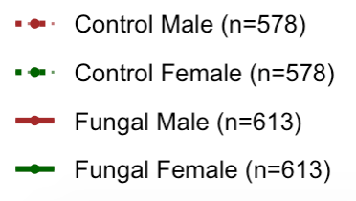
I thought this was done 4 times. How come there are only two sets of dots? Should be 4?
Notes:
EXCLUDE. Figure S3. Experiment 3. Effects of diet on post-inoculation survival of D. melanogaster inoculated with B. bassiana strain GHA. Dots show data from each experiment and lines are the means of this data.

Slide 25
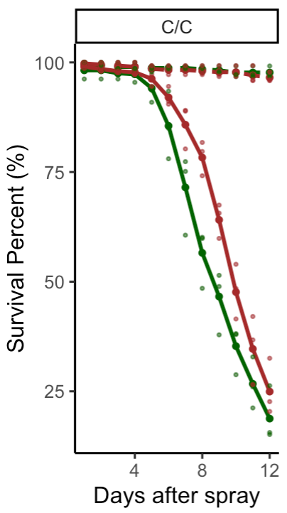
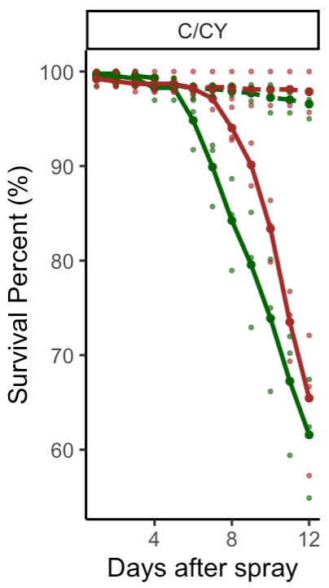
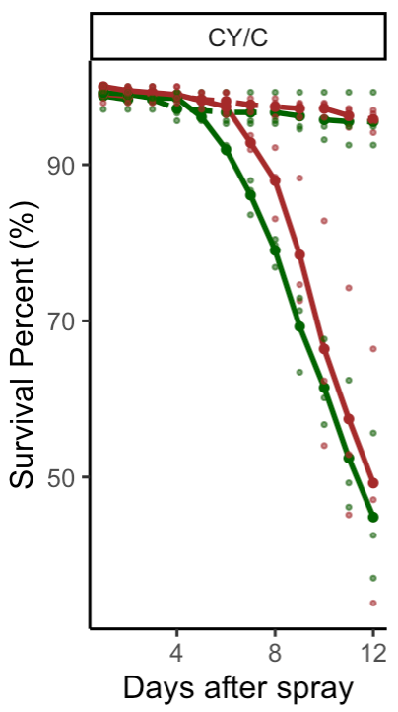
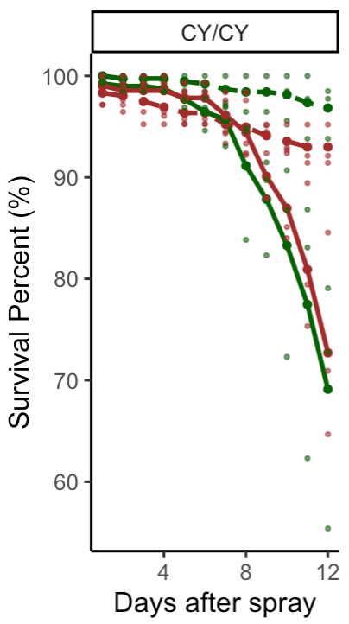
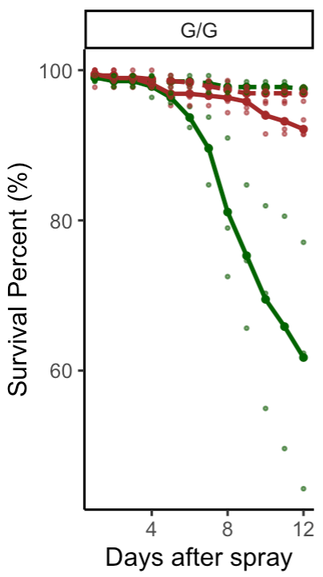
I thought this was done 4 times. How come there are only two sets of dots? Should be 4?
Notes:
EXCLUDE. Figure S2. Yeast supplementation affects sexual dimorphism in survival of D. melanogaster inoculated with B. bassiana strain GHA. Points show raw data from four replicates of this study and lines are the means of these replicates.

Slide 26
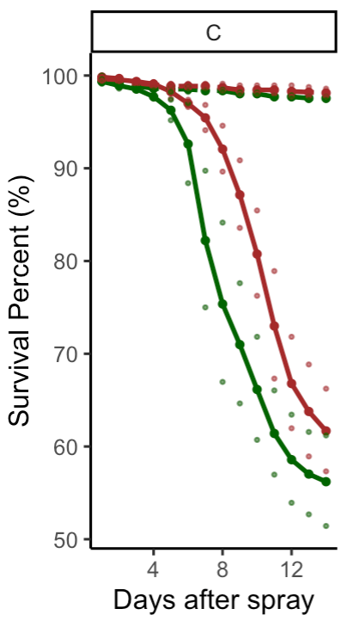
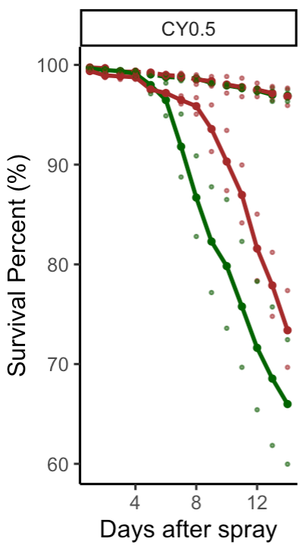
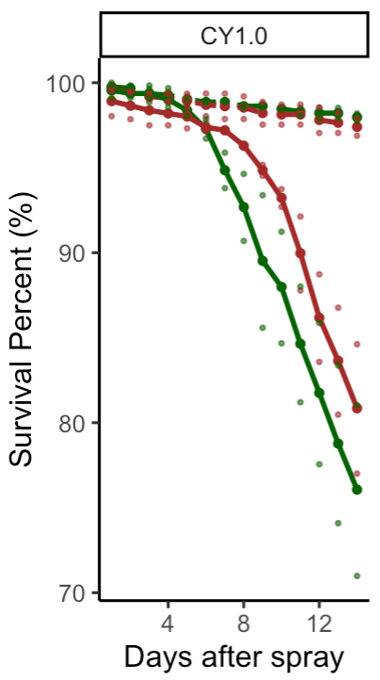
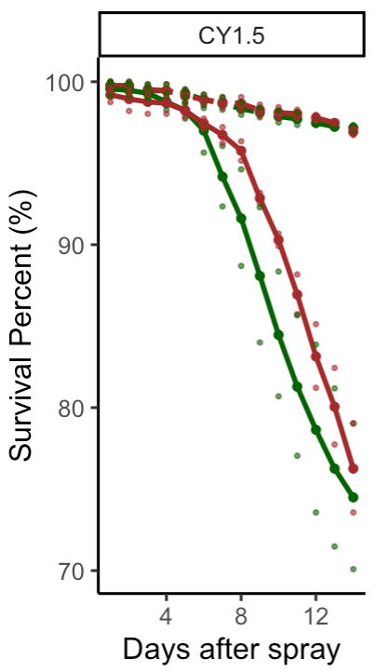
Cut off data at 12
Notes:
EXCLUDE. Figure S5. Effects of yeast supplementation on sexual dimorphism of D. melanogaster inoculated with B. bassiana. Dots show raw data from four replicate experiments and the lines show the means of this data.

